Slide 1
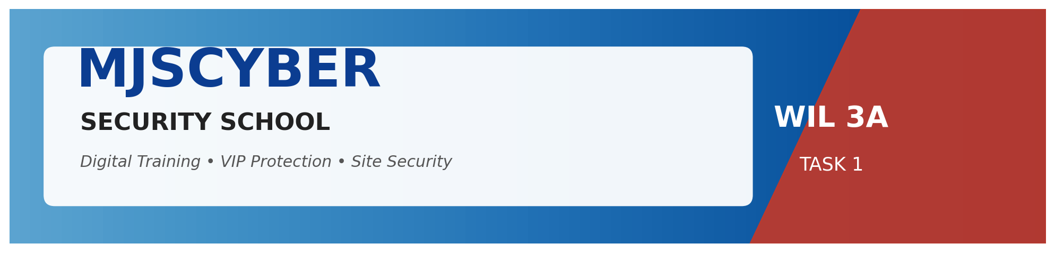
WIL — WORK INTEGRATED LEARNING 3A | XISD5319
MJSCYBER Security School
Web Application & Database — Digital Transformation Project
PRESENTED BY
Jones Sepuru • Khumela Sendelani
MJSCYBER PTY LTD · Reg 2022/201980/07 · Bochum, Limpopo

Slide 2
00
The Presentation
What we will cover today
❖ About the Company
❖ Vision
❖ Mission
❖ Research — Internal & External
❖ Summary of Results
❖ Organogram / Organisational Structure
❖ Problems Experienced by Organisation
❖ Database / Tables / ERD
❖ Solution / Prototype
❖ Screenshots of the Web App
❖ Requirements
❖ Risks and Benefits
MJSCYBER Security School · WIL 3A Presentation · XISD5319
2 / 14

Slide 3

01
About the Company
MJSCYBER PTY LTD
Reg 2022/201980/07 · Established 2022
❖ PSIRA-accredited private security training provider.
❖ Based in Bochum, Limpopo — serving the entire province and beyond.
❖ Trains guards from Grade E (entry) through to Grade A (senior management).
❖ Offers VIP Protection, Armed Response and Construction-Site Security services.
❖ 5+ years of operational experience and continued growth.
MJSCYBER Security School · WIL 3A Presentation · XISD5319
3 / 14

Slide 4
02
Vision
“
A South Africa where every security credential is instantly verifiable, every site is protected by well-trained professionals, and every community — including our home of Bochum — benefits from safer public and commercial spaces.
— MJSCYBER Vision Statement
MJSCYBER Security School · WIL 3A Presentation · XISD5319
4 / 14

Slide 5
03
Mission
“
To elevate the South African private-security sector by producing disciplined, certified and digitally-verifiable guards — and to deliver specialised protection services that meet the highest standards of professionalism.
— MJSCYBER Mission Statement
MJSCYBER Security School · WIL 3A Presentation · XISD5319
5 / 14

Slide 6
04
Research — Internal & External
Where we got our information
INTERNAL RESEARCH
EXTERNAL RESEARCH
Inside MJSCYBER
Industry & Regulation
❖ Interviews with the MJSCYBER director.
❖ Walk-throughs of the manual registration process.
❖ Existing PSIRA training material & policies.
❖ Sample paper certificates & guard rosters.
❖ Inventory of hardware/software currently in use.
❖ PSIRA Act & accreditation requirements.
❖ POPIA — data-protection compliance.
❖ Stripe & PayFast payment-gateway documentation.
❖ Benchmark websites of competing security schools.
❖ Open-source toolchain research (FastAPI, React, Mongo).
MJSCYBER Security School · WIL 3A Presentation · XISD5319
6 / 14

Slide 7
05
Summary of Results
Headline findings from our research
100%
3 days
R9 500
500+
Paper-based today
Avg. cert turnaround
Lost per month (admin)
Guards trained to date
Key insights
❖ MJSCYBER is competitive in training quality but trails competitors on digital presence.
❖ Manual record-keeping is the single biggest source of administrative cost.
❖ Corporate clients increasingly demand verifiable certificates before signing contracts.
❖ All required technology is open-source — no licence cost barrier.
❖ Local connectivity is workable with a cloud-hosted, lightweight web architecture.
MJSCYBER Security School · WIL 3A Presentation · XISD5319
7 / 14

Slide 8
06
Organogram
MJSCYBER organisational structure
DIRECTOR
Mr M.J. Sepuru
TRAINING MANAGER
OPERATIONS MANAGER
ADMIN MANAGER
Curriculum & Instructors
VIP & Site Security
Finance & Compliance
Instructors
Guards / Drivers
Admin Clerk
Theory & Practical
Field Operatives
Bookings & Records
IT / WEB ADMIN (NEW)
Maintains digital platform
MJSCYBER Security School · WIL 3A Presentation · XISD5319
8 / 14

Slide 9
07
Problems Experienced by MJSCYBER
Pain points identified during research
⏱
Slow administration
📄
Paper certificate fraud
📞
Booking chaos
Manual registration & grading takes 3+ days per student.
Printed certificates are easy to forge — damaging the brand.
VIP & site requests are taken by phone, often forgotten.
💸
Lost revenue
📈
No visibility
🌐
Poor online presence
Roughly R9 500 per month is lost to admin inefficiency.
No dashboard showing enrolments, revenue or compliance.
Competitors are easier to find online → lost enquiries.
MJSCYBER Security School · WIL 3A Presentation · XISD5319
9 / 14

Slide 10
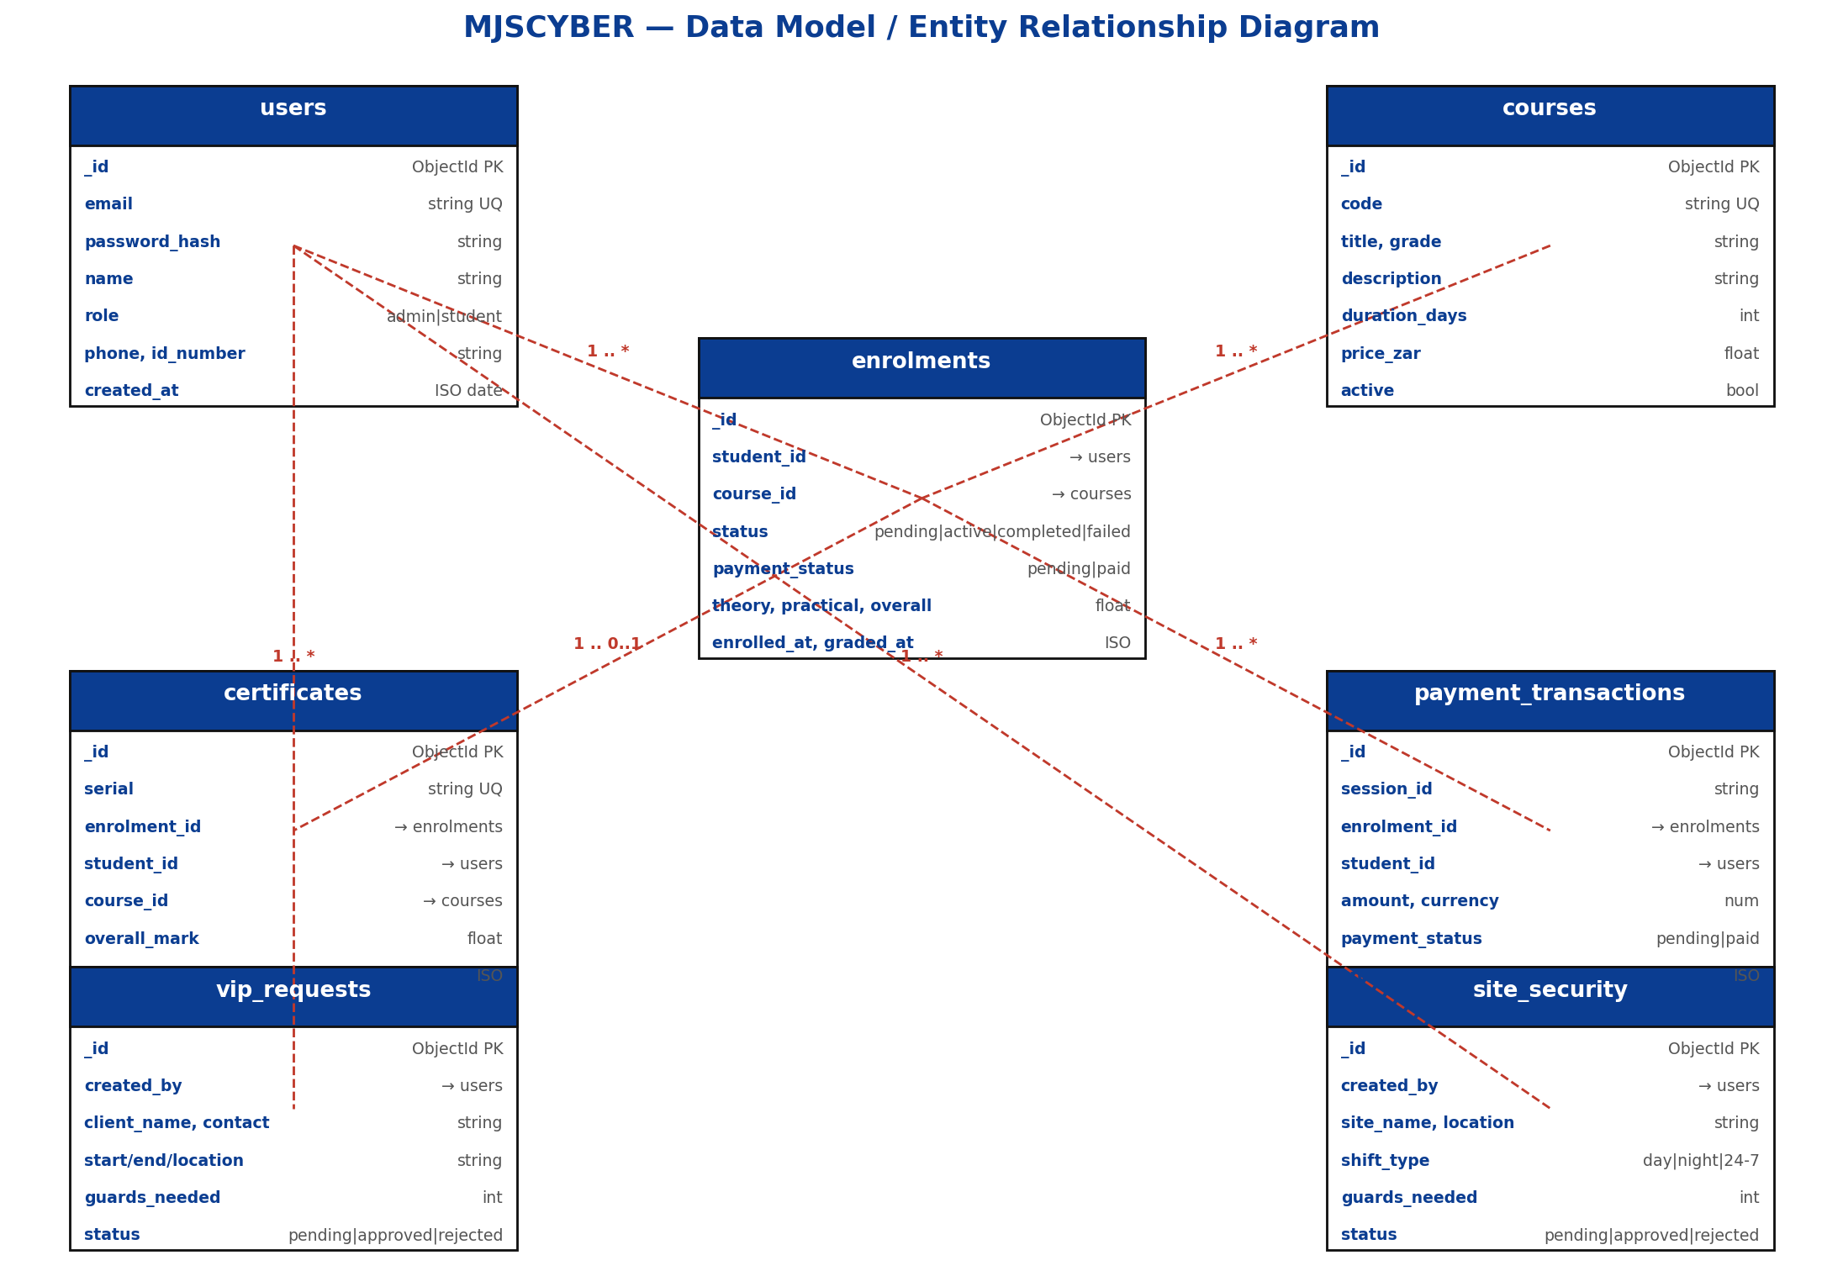
08
Database / Tables / ERD
MongoDB collections and their relationships
Collections
❖ users (auth + profile)
❖ courses (catalogue)
❖ enrolments (lifecycle)
❖ certificates (serial + QR)
❖ vip_requests
❖ site_security
❖ payment_transactions
❖ login_attempts
MJSCYBER Security School · WIL 3A Presentation · XISD5319
10 / 14

Slide 11
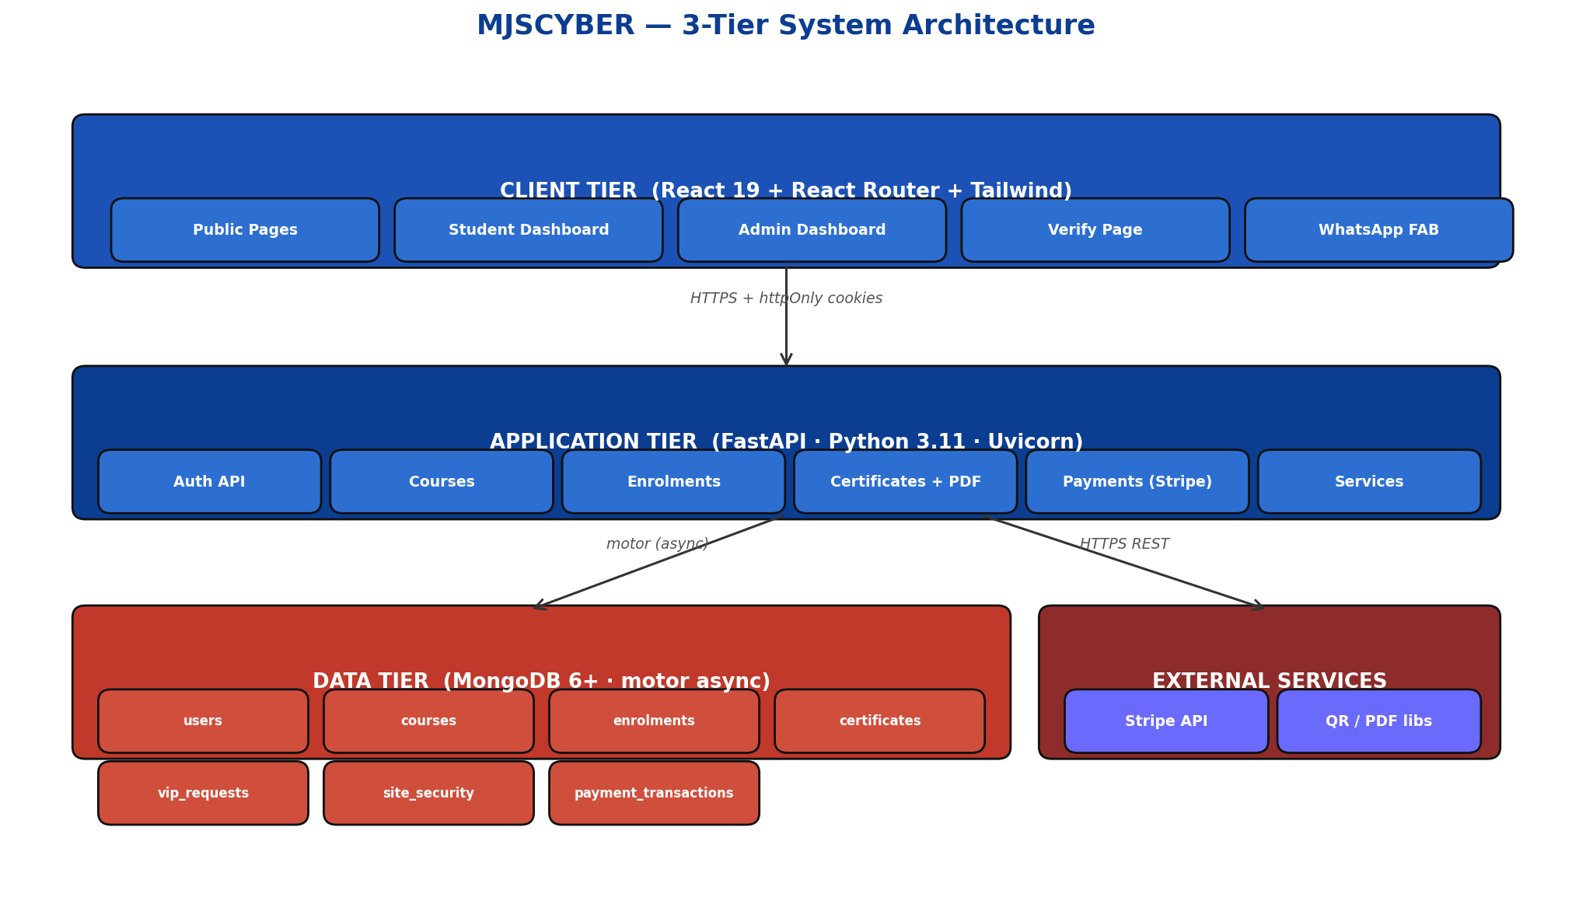
09
Solution / Prototype
A modern web platform that digitises every workflow
What we built
❖ Public marketing site (Landing, About, Verify)
❖ Online student registration & enrolment
❖ Stripe Checkout for tuition payments
❖ Digital grading & qualification engine
❖ Tamper-proof PDF certificates with QR code
❖ VIP & site-security booking module
❖ Admin control centre with live KPIs
❖ WhatsApp click-to-chat support
MJSCYBER Security School · WIL 3A Presentation · XISD5319
11 / 14

Slide 12
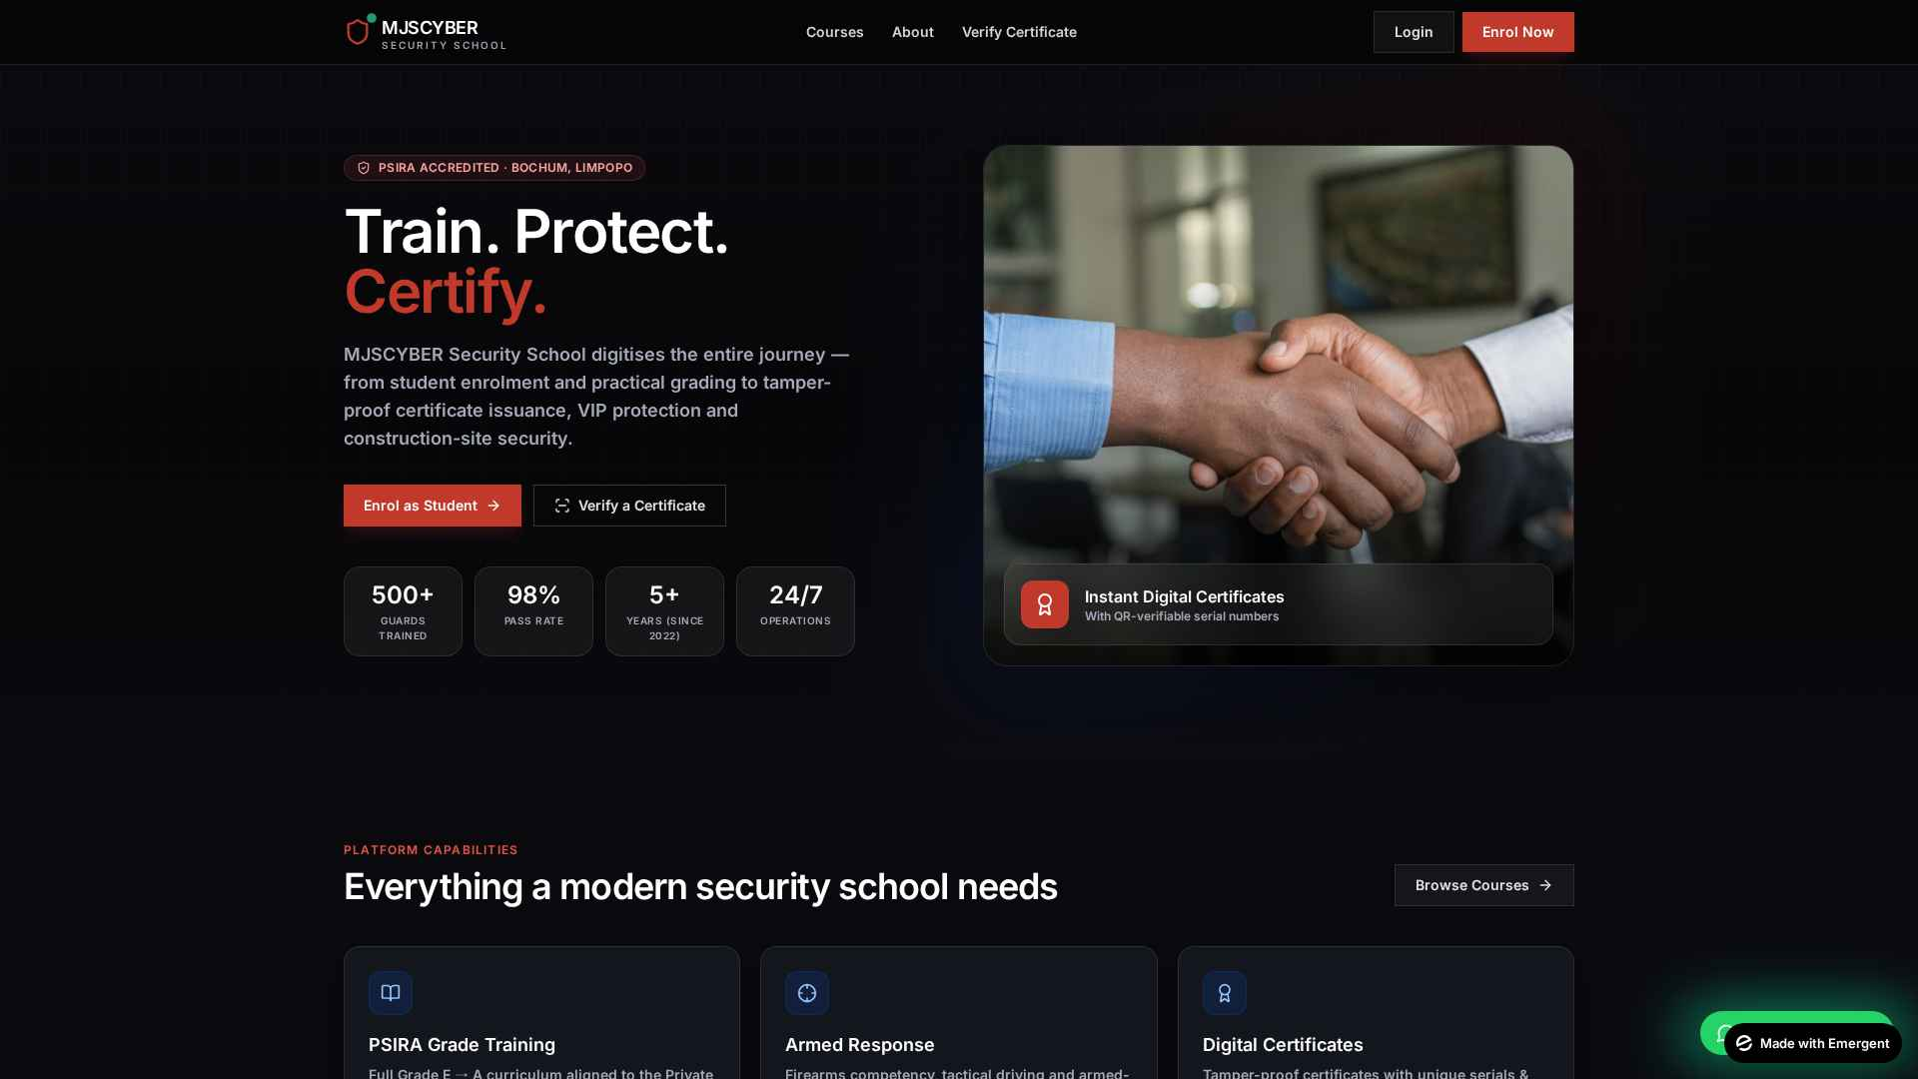
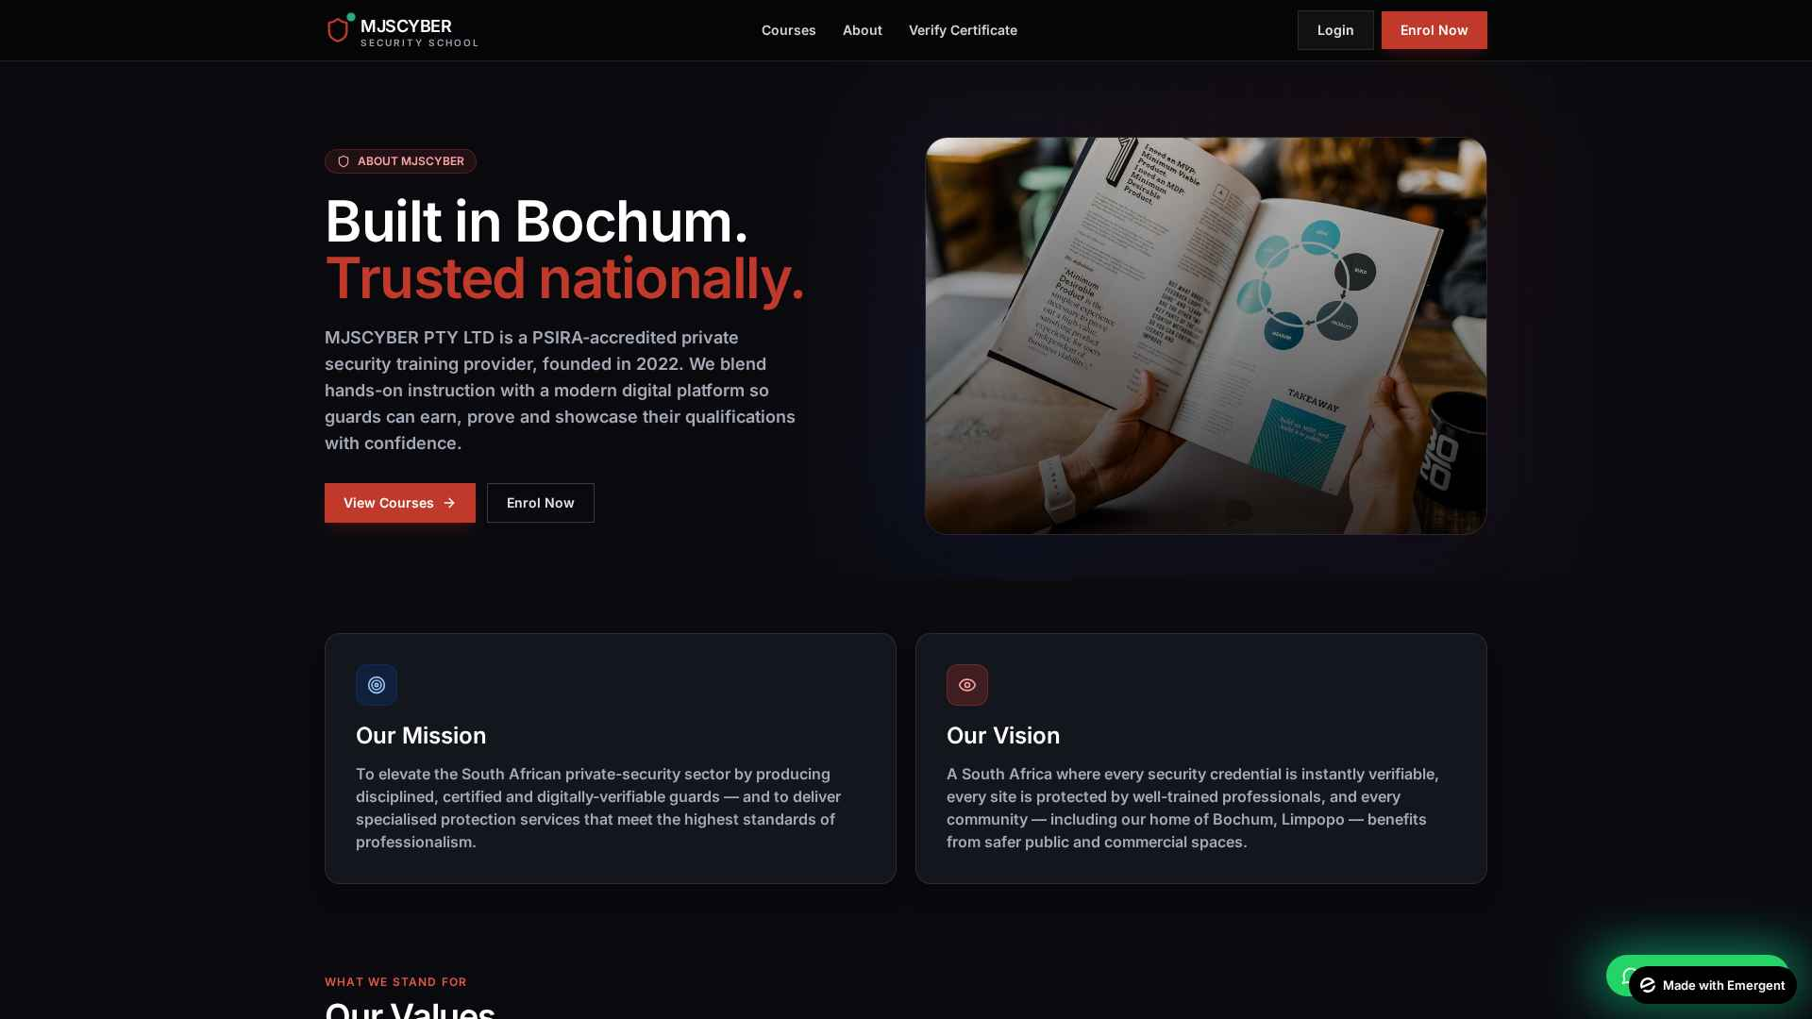
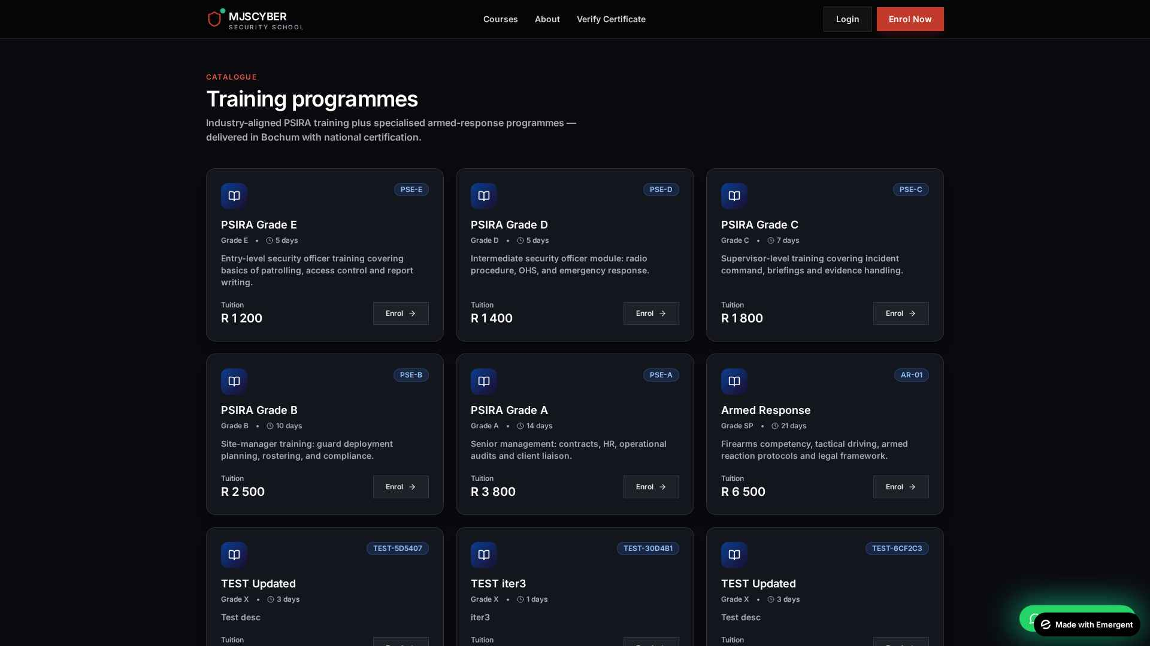
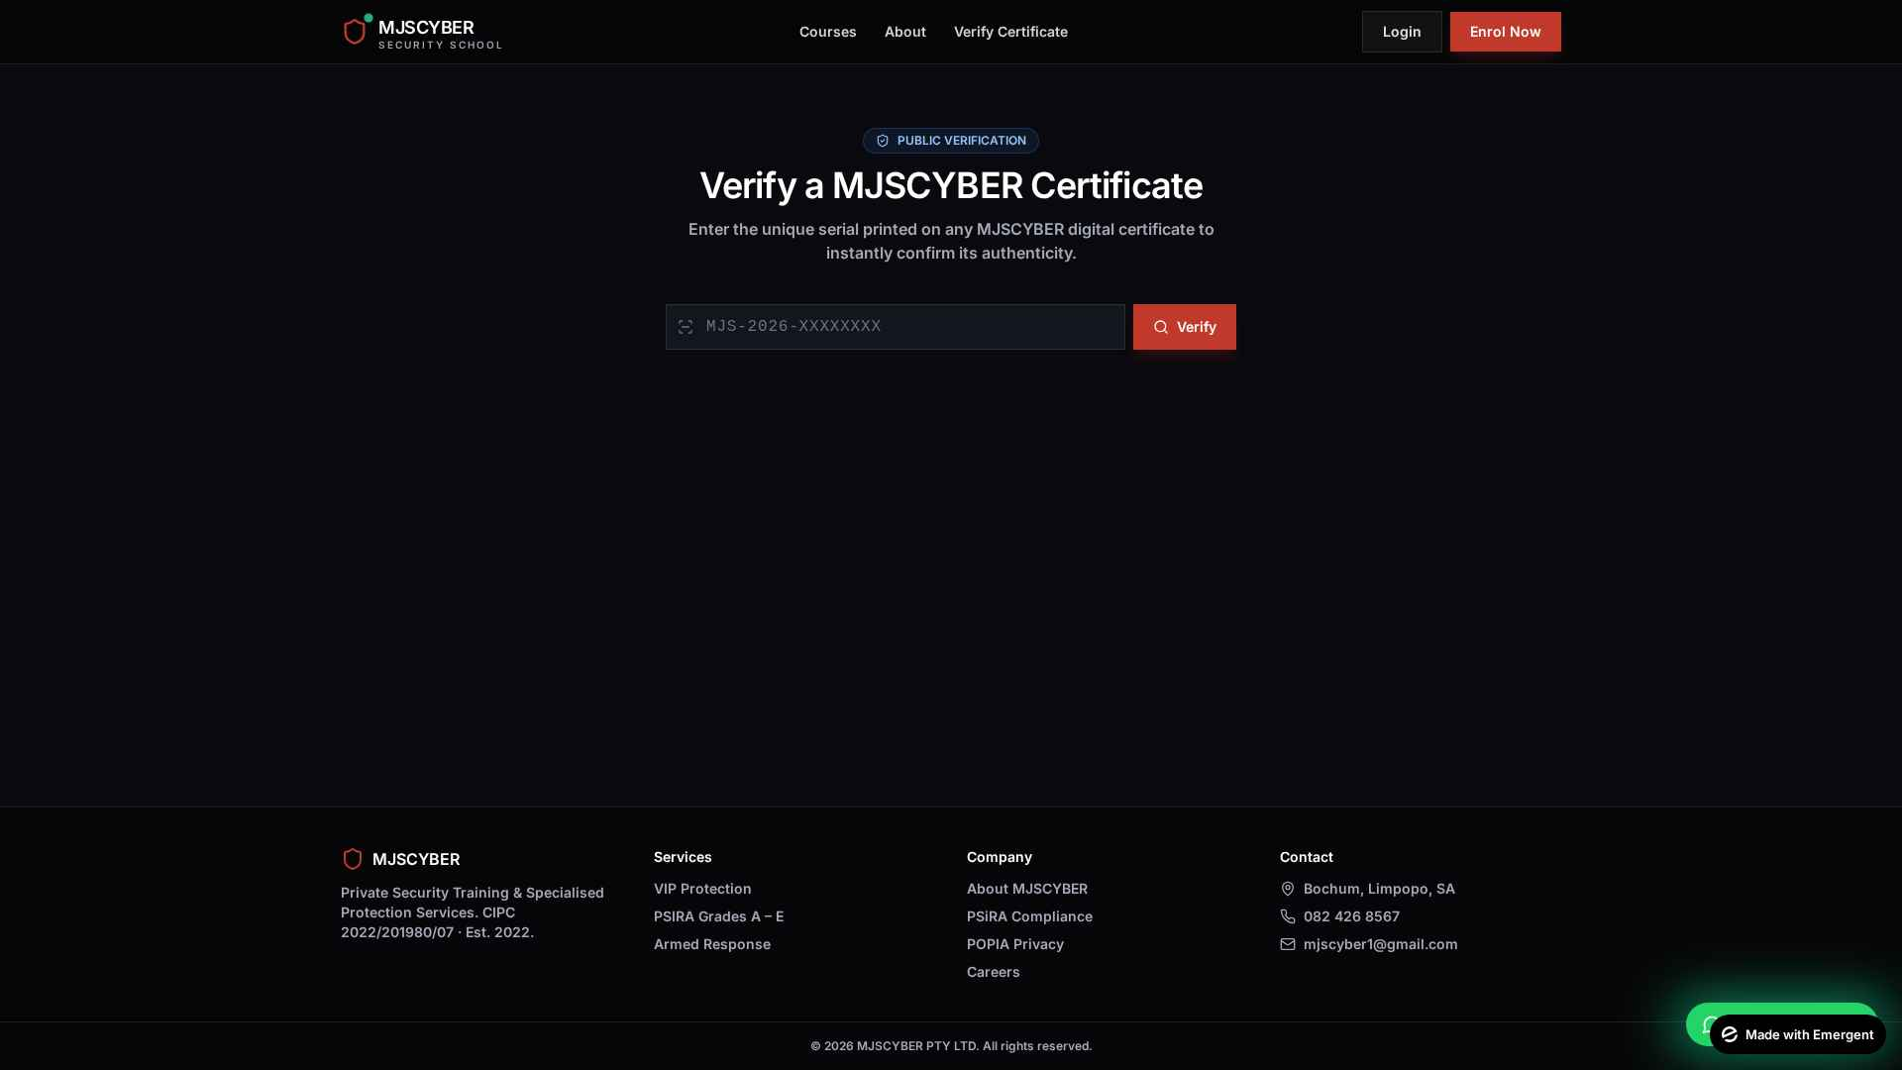
10
Screenshots
Public-facing pages
Figure 1 — Landing page
Figure 2 — About page (mission, vision, timeline)
Figure 3 — Course catalogue
Figure 4 — Public certificate verify
MJSCYBER Security School · WIL 3A Presentation · XISD5319
12 / 14

Slide 13
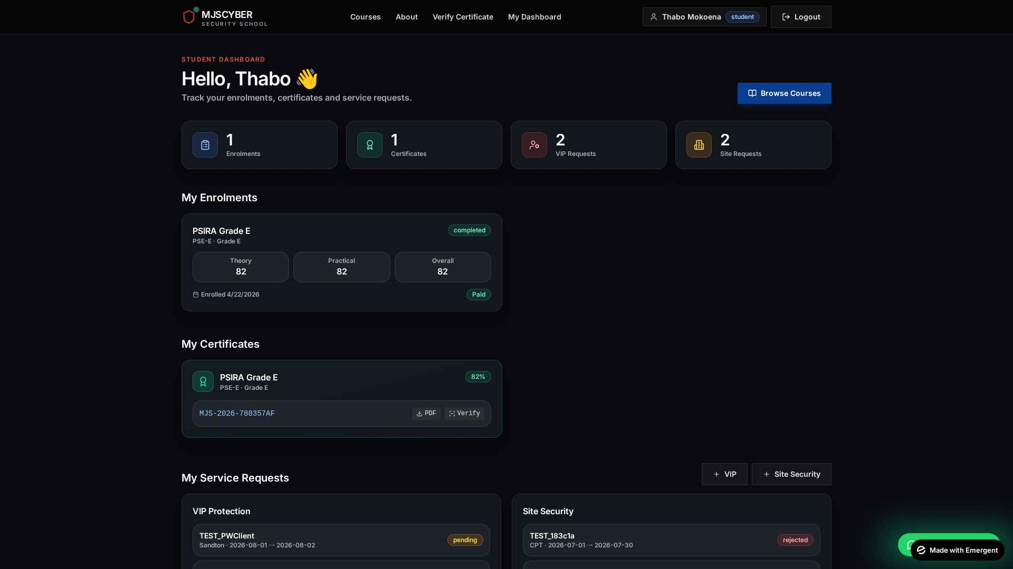
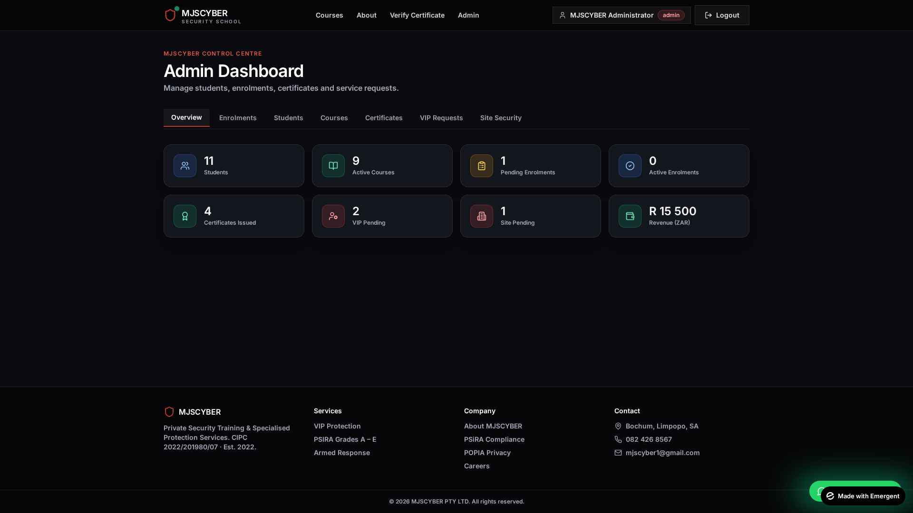
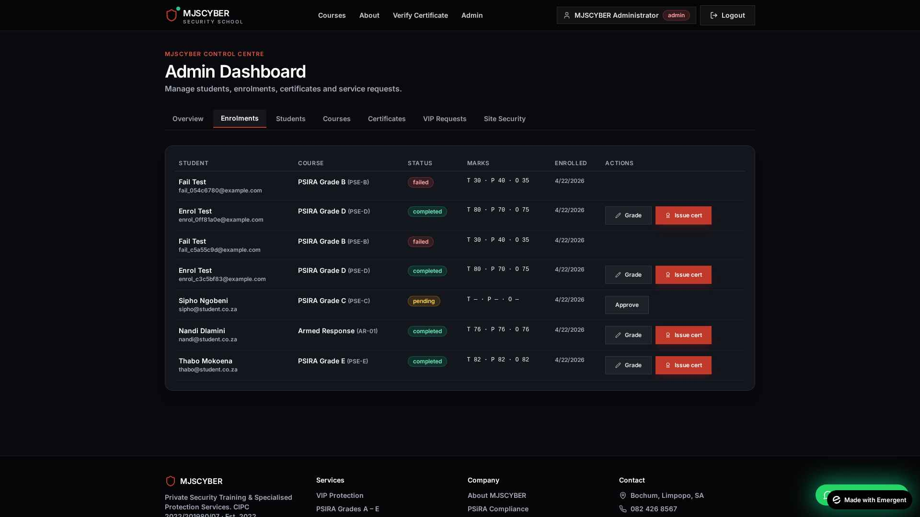
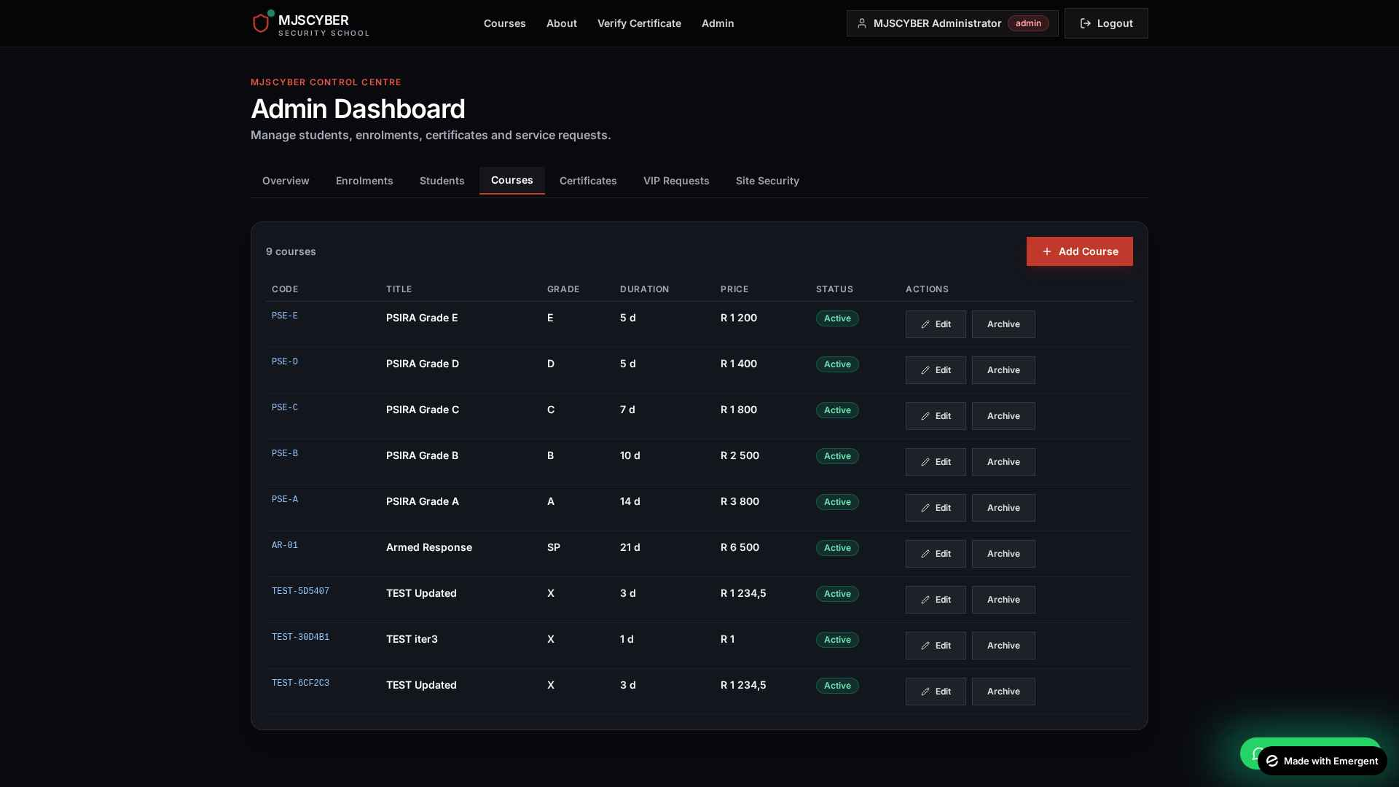
10
Screenshots
Dashboards & administration
Figure 5 — Student dashboard
Figure 6 — Admin overview (KPIs & revenue)
Figure 7 — Admin enrolments + grading
Figure 8 — Admin courses (Add/Edit)
MJSCYBER Security School · WIL 3A Presentation · XISD5319
13 / 14

Slide 14
11
Requirements
What the system needs to run
FUNCTIONAL
TECHNICAL
❖ User registration & secure login (admin / student).
❖ Course catalogue with online enrolment.
❖ Online payments in ZAR (Stripe Checkout).
❖ Grading workflow with auto pass/fail.
❖ Issue & download PDF certificates with QR.
❖ Public certificate verification page.
❖ VIP & site-security booking and approval.
❖ Live admin KPIs and revenue dashboard.
❖ Hardware: 2× laptops (i5 / 8 GB / 256 GB SSD), UPS, 4G router.
❖ Hosting: Afrihost cPanel / Atlas-hosted MongoDB.
❖ Backend: Python 3.11 + FastAPI + motor.
❖ Frontend: React 19 + Tailwind + React Router.
❖ Database: MongoDB 6+.
❖ Integrations: Stripe (test) + ReportLab + qrcode.
❖ Tools: VS Code, GitHub, Postman, Figma.
❖ Operational: SSL (Let's Encrypt), daily backups.
MJSCYBER Security School · WIL 3A Presentation · XISD5319
14 / 14

Slide 15
12
Risks and Benefits
Trade-offs we have managed
TOP RISKS (with mitigations)
EXPECTED BENEFITS
❖ Load-shedding — cloud hosting + UPS + 4G hotspot.
❖ Scope creep — signed scope + change-request log.
❖ Data-security breach — bcrypt, HTTPS, RBAC, encrypted store.
❖ Key-person dependency (2-member team) — cross-training & Git.
❖ Rural low-bandwidth — lightweight FE, image compression.
❖ Budget overrun — 9% contingency, prefer open-source tools.
❖ 70% reduction in administrative time per intake.
❖ Tamper-proof certificates → stronger client trust.
❖ Real-time scheduling replaces phone-based booking.
❖ POPIA / PSIRA compliance baked in from day 1.
❖ Cloud-ready architecture supports multi-campus growth.
❖ ROI payback in ~9 months on R 84 500 budget.
MJSCYBER Security School · WIL 3A Presentation · XISD5319
15 / 14

Slide 16
Thank You
Questions & Discussion
CONTACT MJSCYBER
📞 082 426 8567 ✉ mjscyber1@gmail.com
Bochum, Limpopo, South Africa

